Slide 1

HOTEL MANAGEMENT SYSTEM
JAVA PROJECT
ADHARSH.S
231501006
AIML-A

Slide 2

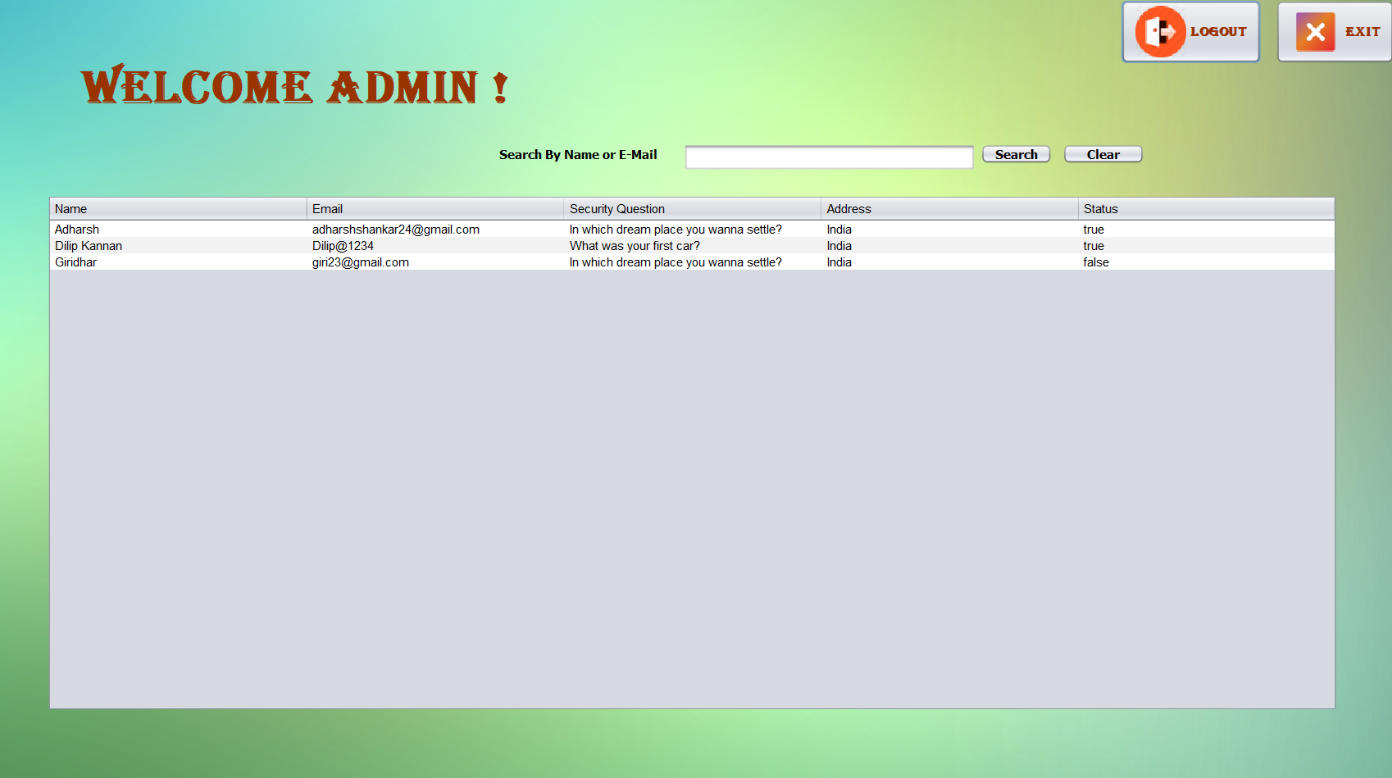
HOME PAGE
THIS IS THE HOME OR ADMIN PAGE WHERE THE PERSON WHO HAVE REGISTERED AND LOGIN IN WOULD BE DISPLAYED

Slide 3
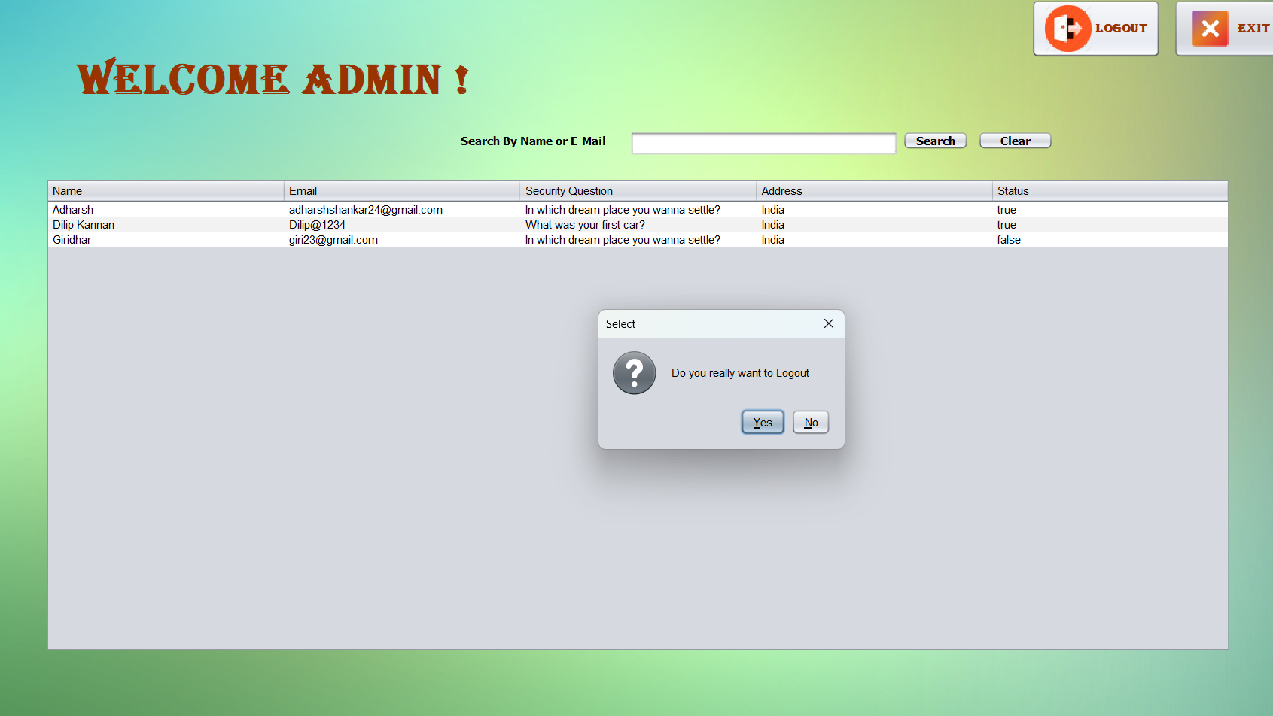
AT FIRST I AM GONNA LOGOUT SO THAT I CAN MOVE BACK TO LOGIN PAGE

Slide 4
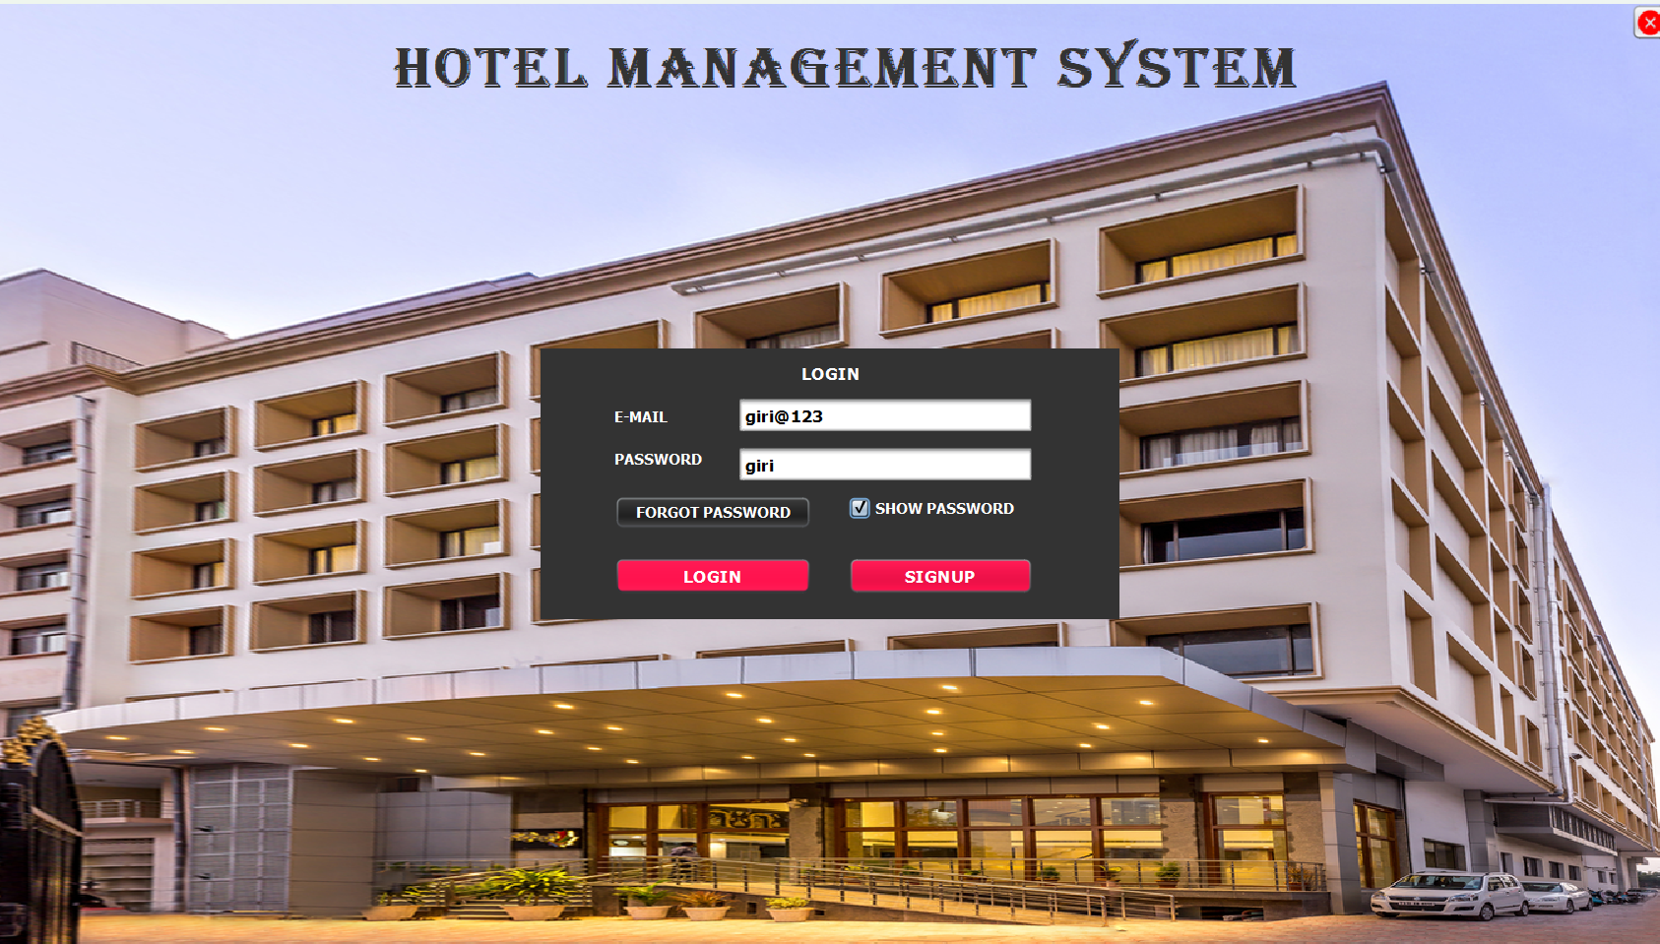
I WANT TO REGISTER USING A NEW ACCOUNT SO I AM GOING BACK TO SIGNUP PAGE

Slide 5
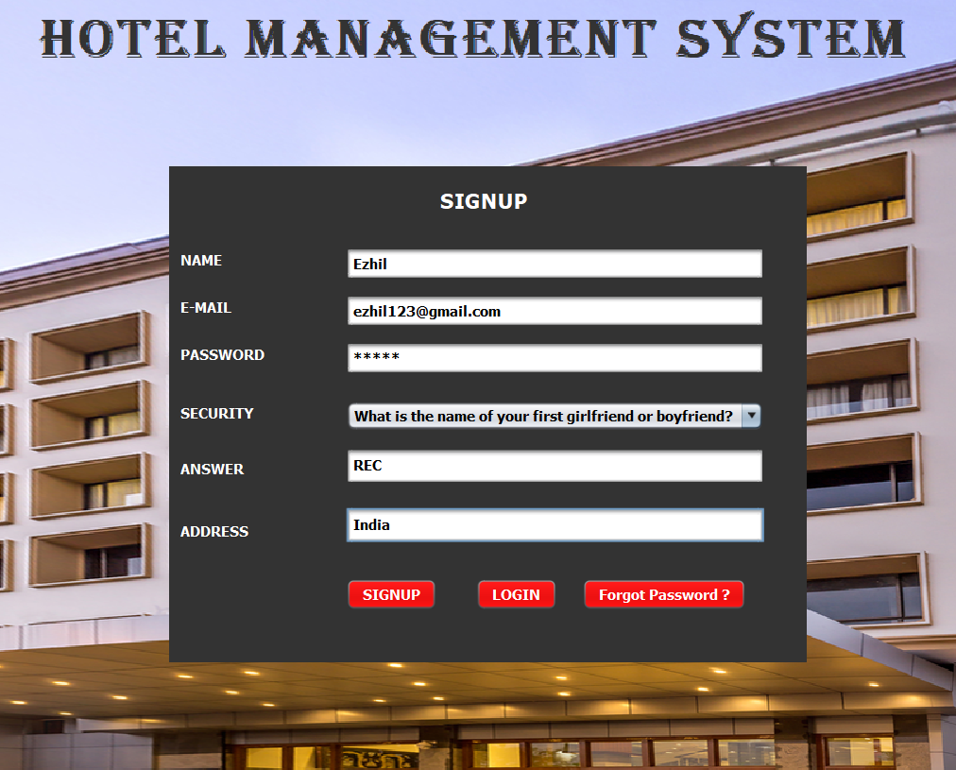
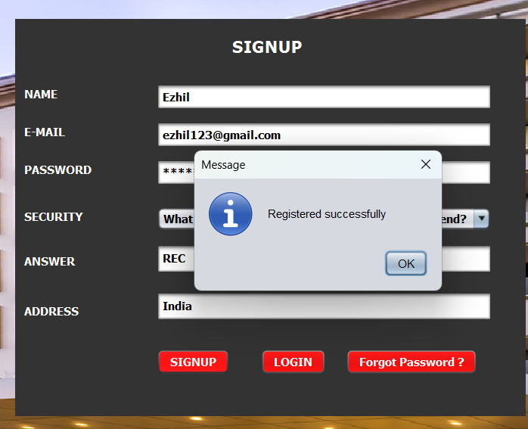
NOW I AM REGISTERING USING A NEW ACCOUNT AND ON CLICKING SIGNUP I HAVE REGISTERED SUCCESSFULLY

Slide 6
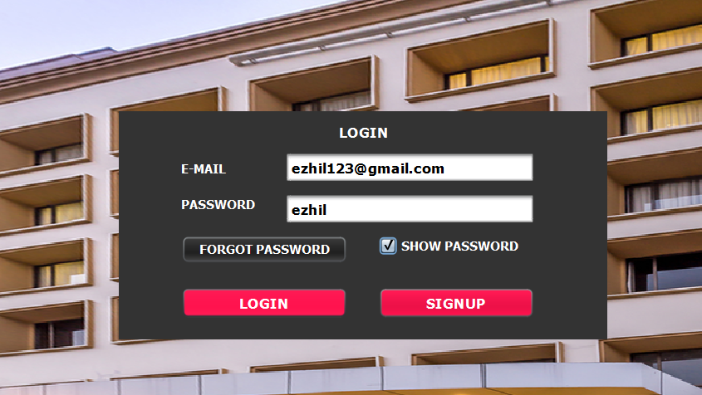

WHEN I TRY TO LOGIN IT HAS SUCCESSFULLY LOGGED IN THAT REACHES TO WHITE PAGE

Slide 7
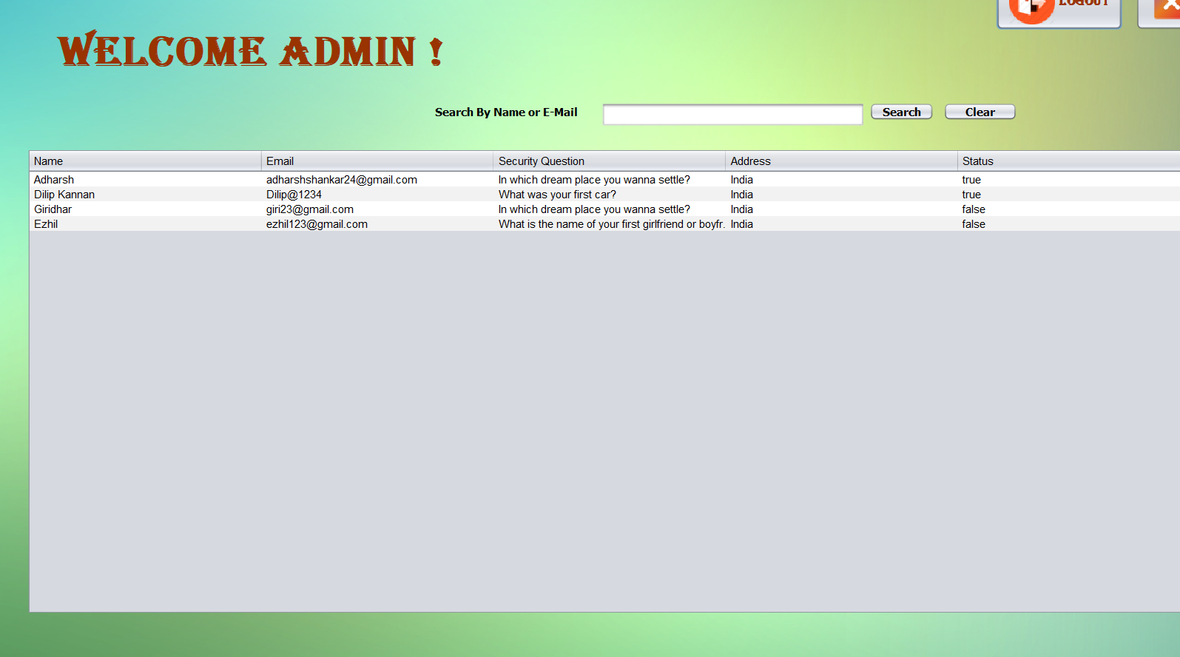
SUCCESSFULLY THE REGISTERED EMAIL HAS BEEN STORED

Slide 8

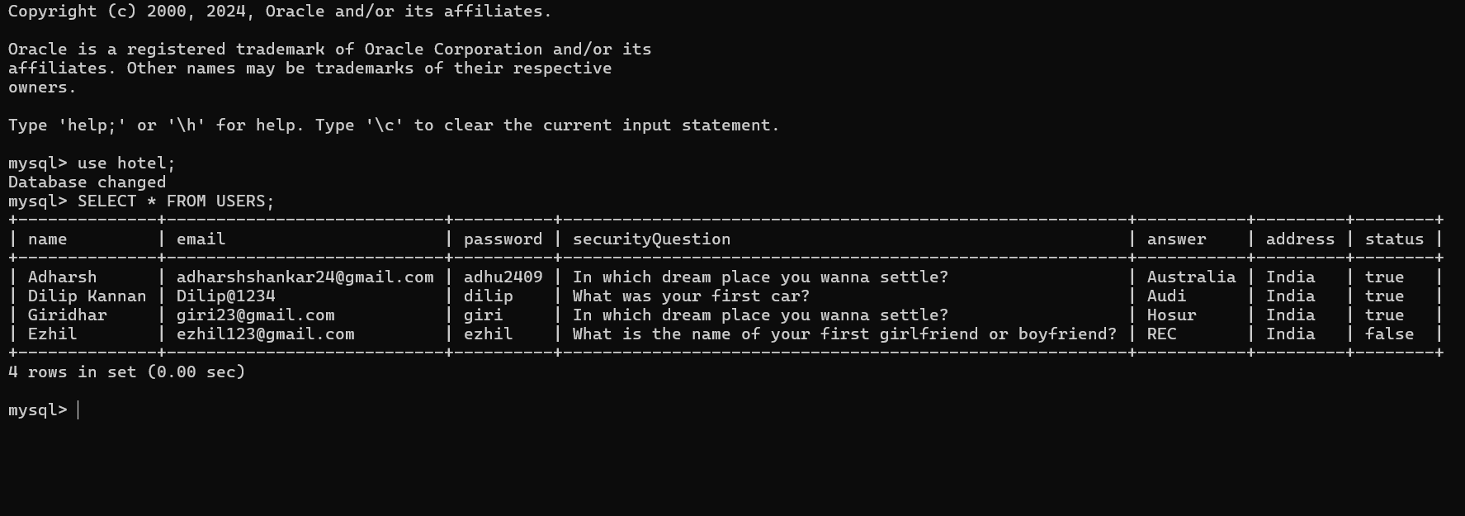
DATABASE
IT HAS BEEN SUCCESSFULLY STORED IN THE DATABASE

Slide 9

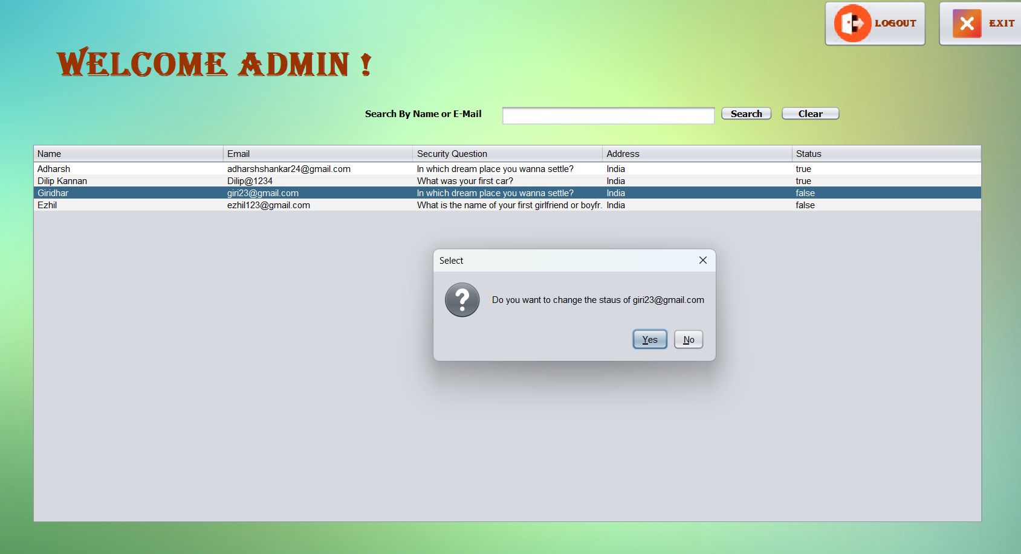
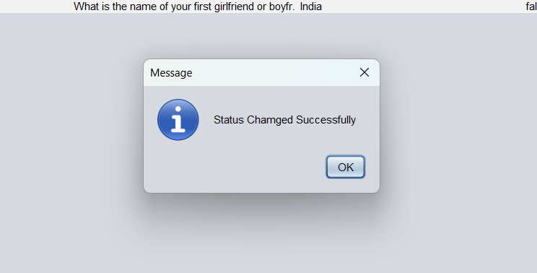
IF WE WANT TO CHANGE THE STATUS OF USER WE CAN CHANGE IT IN THE HOME PAGE BY CLICKING THE USER
ADDITIONALLY WE CAN ALSO SEARCH AN USER BY THEIR NAME OR EMAIL

Slide 10

THANK YOU

